Slide 1
ATUGUBA & ASSOCIATES
The Cyber Security Act 2020 (Act 1038): Yet another Act of Parliament or a Potent Tool in Dealing with the Menace of Cyber Crime?
MONTHLY CLE
Setor Foe-Ahorney
28th May, 2021

Slide 2
OUTLINE OF PRESENTATION
Introduction
Definition of some key terms
Applicability of the Act
General Overview of the Act
African Union Convention on Cyber Security and Personal Data Protection
Strengths and Weaknesses of the Act
Conclusion: Potent Tool or Not?

Slide 3
INTRODUCTION
Increasing reliance on ICT in Ghana has led to increased cybersecurity incidents
Ghana lost US$ 230 million between 2016 and 2018 to cybercrime (The Finder, 2018)
CYBER SECURITY ACT, 2020 (Act 1038) was passed to regulate cyber activities in Ghana
Cybersecurity Policy and Strategy

Slide 4
CYBER THREAT LANDSCAPE
Insider Threats
Ransomware/ Malware Attacks
Social Engineering Attacks (Phishing, Identity Theft etc)
Hacking
Mobile Device Security Threats
DoS Attacks
Advanced Persistent Threats (APTs)
Current State of Cybercrime in Ghana
Cyber Fraud
Data Breaches
Website Defacement
Others
Social Media Threats
E-Paymemnt Threats (Mobile Money)
Fake News

Slide 5
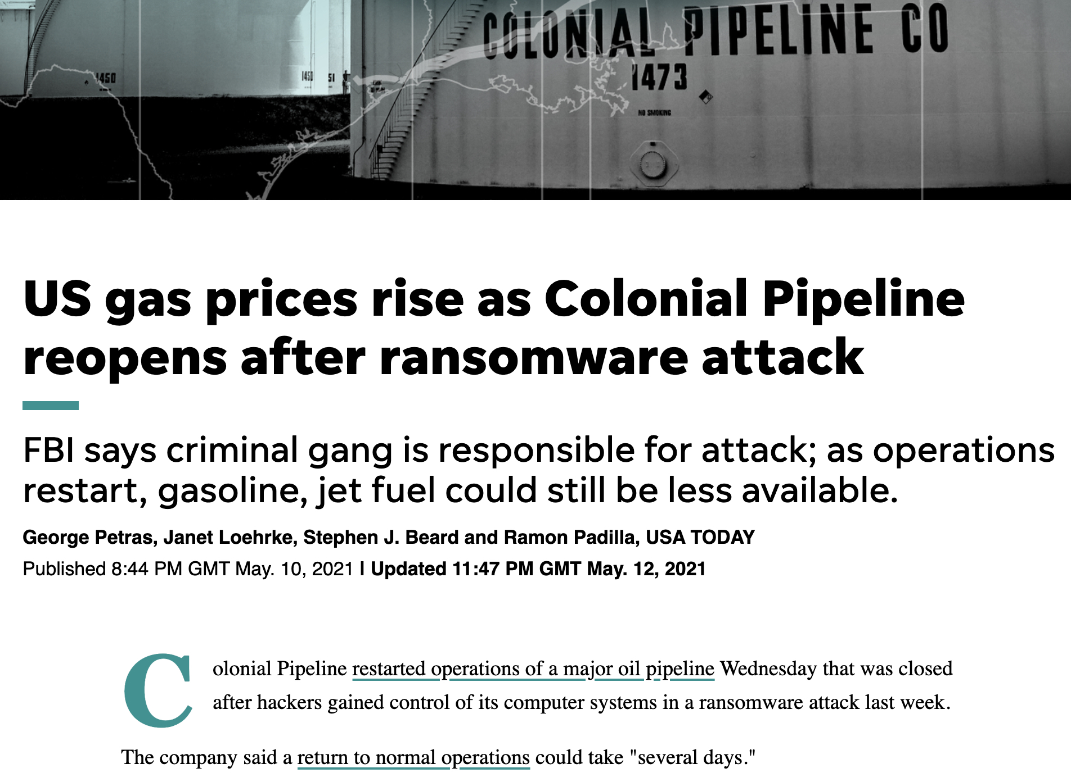
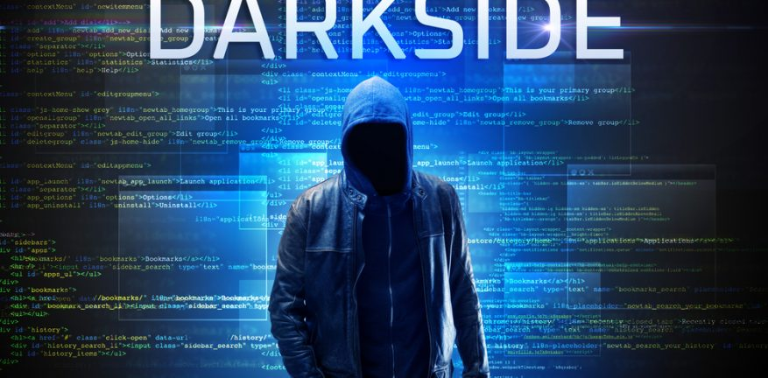
AN EXAMPLE OF CYBER THREAT IN THE USA
The USA gas company, Colonial Pipeline, had its network taken over by Darkside ransomware. The scammers in Russia demanded US$ 5 million in cryptocurrency

Slide 6
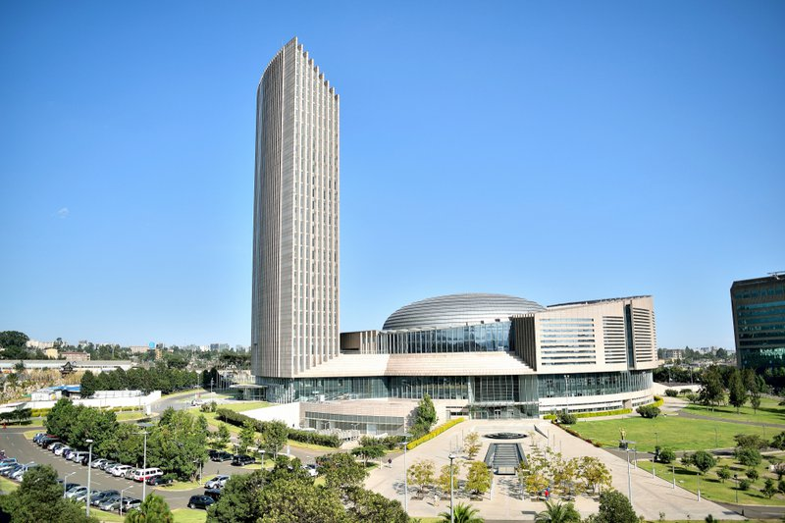
AN EXAMPLE OF CYBER THREAT IN AFRICA
The purported data theft by the Chinese government at the African Union headquarters in Addis Ababa, Ethiopia.
The said act was alleged to have taken place over a period of 5 years before being discovered.

Slide 7
AN EXAMPLE OF CYBER THREAT IN GHANA
In 2016, electronic transmission of election results was compromised – Electoral Commission Chairperson

Slide 8
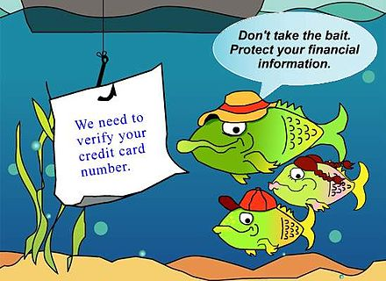
AN EXAMPLE OF CYBER THREAT AT A&A
Phishing attack on A&A. The scammer posed as Prof. Raymond Atuguba requesting GHS 50,000 to pay a client.

Slide 9
DEFINITION OF SOME KEY TERMS
CYBERSECURITY means the state in which a computer or computer system is protected from unauthorized access or attack for the purpose of ensuring that the information stored on such computer systems are protected.
CYBERSECURITY INCIDENT means an act or an attempt to gain unauthorized access to disrupt or misuse an information stored on a system.
CYBERSPACE means a technology infrastructure comprising of telecom network, the internet, computer networks and information systems.

Slide 10
DEFINITION OF SOME KEY TERMS
COMPUTER SYSTEM means an arrangement of interconnected computers that is designed to perform one or more specific functions, and includes an information system; an operational technology system, a programmable logic controller, a supervisory control and a data acquisition system.
CYBERCRIME means the use of cyberspace or any electronic facility to commit a crime.

Slide 11
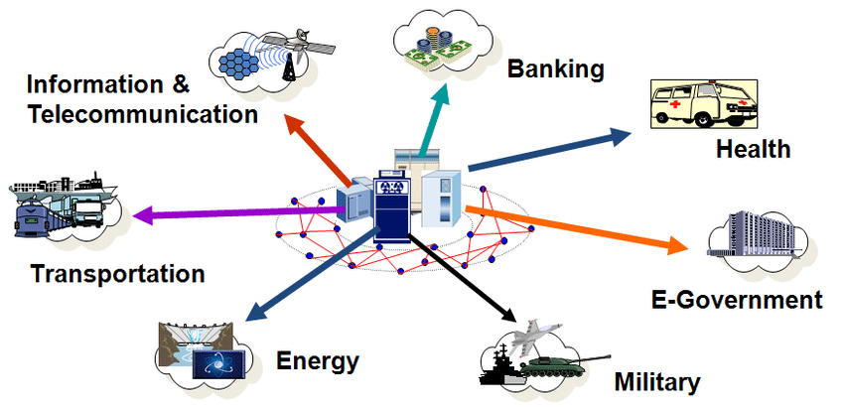
DEFINITION OF SOME KEY TERMS
CRITICAL INFORMATION INFRASTRUCTURE (CII) is any data, database, network, communications infrastructure, (or part thereof), or anything associated with them that has been declared a CII
Critical Information Infrastructure in various areas

Slide 12
APPLICABILITY OF THE ACT
The Act applies to cyber security in the country and should be read together with other relevant Acts such as;
Criminal and other offences Act, 1960 (Act 29)
Evidence Act, 1975 (N.R.C.D. 323)
The Foreign Exchange Act, 2006 (Act 723)
Anti-Money Laundering Act, 2008 (Act 749)
Electronic Transactions Act, 2008 (Act 772)
Electronic Communications Act, 2008 (Act 775)
Economic and Organized Crime Office Act, 2010 (Act 804)
Mutual Legal Assistance Act, 2010 (Act 807)
Data Protection Act, 2012 (act 843); and
Payment Systems and Services Act, 2019 (Act 987)

Slide 13
GENERAL OVERVIEW OF THE ACT A. The Cyber Security Authority
Some of the functions of the authority includes to;
Advise government and public institutions on matters relating to cyber security
Certify cybersecurity products and services
Promote the protection of children online
Establish and maintain a framework for dissemination of information on cybersecurity
Educate the public on cybercrime and cybersecurity
Collaborate with law enforcement agencies on matters relating to cybersecurity.

Slide 14
GENERAL OVERVIEW OF THE ACT B. Governance of the Authority
The governing authority consist of;
the Ministers responsible for Communications, Interior, National Security and Defense.
Director-General of the Authority appointed by the President under article 195
three persons from the Industry Forum nominated by the Industry Forum
three other persons nominated by the President on the advice of the Minister, at least two of whom are women
The chairperson and other members of Board shall be appointed by the President in accordance with Article 70 of the Constitution, 1992.

Slide 15
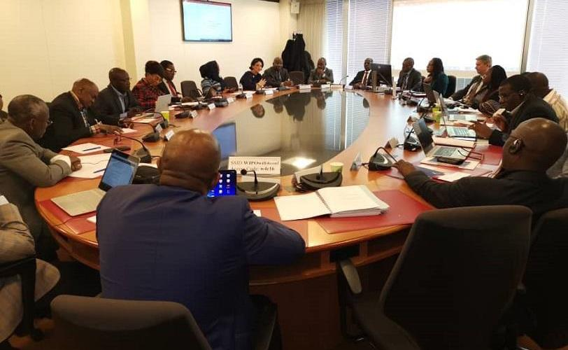
GENERAL OVERVIEW OF THE ACT B. Governance of the Authority
The Act shall establish a Joint Cybersecurity Committee from key sectors to collaborate with the Authority to implement the relevant cybersecurity measures.

Slide 16
GENERAL OVERVIEW OF THE ACT C. Establishment of a Cybersecurity Fund
Sources of moneys for the fund (Sec 31)
Seed money approved by Parliament
Moneys lawfully payable to the Authority
Grants, gifts, donations and other voluntary contributions
A charge determined by the Authority in accordance with the Fees and Charges (Miscellaneous) Act, 2018 (Act 983) and levied on persons licensed by the Bank of Ghana to carry on business
A proportion of the fees charged on all government e-services determined by the Authority in accordance with the Fee and Charges (Miscellaneous Provisions) Act, 2018 (Act 983)
A levy that may be imposed by Parliament on e-services
Any other moneys approved by Parliament for the funds

Slide 17
GENERAL OVERVIEW OF THE ACT D. Critical Information Infrastructure – Sec 35
The Minister may designate a computer system or computer network as a CII if the computer system or computer network is essential for national security, or the economic and social well-being of citizens and such designation shall be published in the gazette.

Slide 18
GENERAL OVERVIEW OF THE ACT E. Critical Information Infrastructure – Sec 35
Ownership is CII is non–transferable
It can be withdrawn when the computer system or computer network no longer satisfies the criteria of a CII.
The minister shall prescribe standards for the general management of a CII.
A periodic audit and inspection on a CII to ensure compliance with the provisions of the Act.

Slide 19
GENERAL OVERVIEW OF THE ACT F. National and Sectoral Computer Emergency Response Team – Sec 41 & 42
National Computer Emergency Response Team (NCERT) – Sec 41
Sectoral Computer Emergency Response Team (SCERT) – Sec 42

Slide 20
GENERAL OVERVIEW OF THE ACT G. Cyber Incident Monitoring and Reporting
Establishment of Cyber Incident Monitoring and Reporting Systems (CIMRS).
The Authority upon receipt of any information of a cybersecurity incident shall circulate the information to SCERT, a licensee or any other relevant institution.

Slide 21
GENERAL OVERVIEW OF THE ACT H. Licensing of Cybersecurity Services Providers
A person shall require a license issued by the Authority to provide cybersecurity service
The license is not transferable and valid for 2 years, subject to renewal.
The license can be revoked and suspended due to disclosed incidence of fraud or misrepresentation and non-compliance respectively

Slide 22
GENERAL OVERVIEW OF THE ACT i. Accreditation and Certification
The Authority shall establish a mechanism for Accreditation of cybersecurity professionals and practitioners (Sec 56) as well as the certification of cybersecurity products and technology solutions (Sec 57)

Slide 23
GENERAL OVERVIEW OF THE ACT J. Cyber Security Standard, Enforcement and Education (Sec 56–61)
The Authority shall develop and adopt standards for cybersecurity in the country.
Engage in Cybersecurity
public awareness and
education and sponsoring
research and developmental
programmes

Slide 24
GENERAL OVERVIEW OF THE ACT K. Protection of Children Online (Sec 62–66)
Indecent image and photograph of a child (Sec 62)

Slide 25
GENERAL OVERVIEW OF THE ACT K. Protection of Children online (Sec 62–66)
Dealing with a child for purposes of sexual abuse (Sec 63)
Prohibition of cyber space to seduce, solicit, lure, groom or entice, or attempt to seduce, solicit, lure,
groom or entice, a child or another
person believed by the person to be
a child.

Slide 26
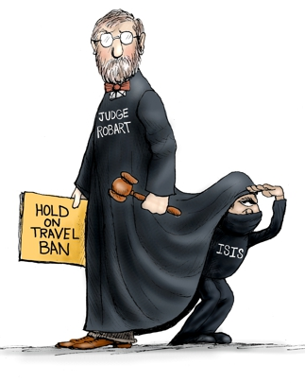
GENERAL OVERVIEW OF THE ACT K. Protection of Children online (Sec 62–66)
Aiding and abetting of a child dealing for purposes of sexual abuse (Sec 64)
It is an offence for an owner or an operator of a computer online service to aid and abet another person for the purpose of encouraging or facilitating the online solicitation of a child.

Slide 27
GENERAL OVERVIEW OF THE ACT K. Protection of Children Online (Sec 62–66)
Cyberstalking of a child ( sec 65)
It is an offence to use cyber space to trade information on a child for the furtherance of unlawful sexual activity

Slide 28
GENERAL OVERVIEW OF THE ACT K. Protection of Children Online (Sec 62–66)
Sexual Extortion (Sec 66)
The Act makes it an offence to threaten to publish private sexually explicit images or videos of a person in order to coerce, harass, threaten, intimidate, exert undue influence or to extort money or other consideration.

Slide 29
GENERAL OVERVIEW OF THE ACT L. Other Online Sexual Offences (Sec 67 & 68)
Non consensual sharing of intimate image with the intention to cause emotional distress
To threaten a person to release a prohibited intimate image

Slide 30
GENERAL OVERVIEW OF THE ACT M. Cybersecurity and Investigatory Powers
An investigative officer may apply ex-parte to the High Court, for a production order to collect subscriber information where there are reasonable grounds to believe that the subscriber information associated with a specified communication and related to or connected with a person under investigation is reasonably required for the purposes of a specific criminal investigation (sec 69)
This production order may be granted where the information requested is commensurate, proportionate and necessary for the purposes of a specific criminal investigation or prosecution and measures shall be taken to ensure that the subscriber information is produced whilst maintaining the privacy of other users, customers and third parties and without the disclosure of information and data of any party not part of the investigation.

Slide 31
GENERAL OVERVIEW OF THE ACT M. Realisation of Property (Sec 78–80)
Freezing assets (78)
Where on an application by the Authority, the Court is satisfied that the Authority has reasonable grounds to suspect that a person has committed or is committing an offence under this Act or has been involved in a crime in cyberspace, the Court may by an order
restrain that person or any other person acting on behalf of that person or a person holding assets on behalf of that person from disposing, transferring or pledging an asset or making a withdrawal from an account or deposit at a bank or financial institution;
attach the assets due or owing, or belonging to, or held by or on behalf of that person;
compel that person to make a full disclosure within the time specified in the order, of all assets and the nature and source of the assets;

Slide 32
GENERAL OVERVIEW OF THE ACT M. Realisation of Property (Sec 78–80)
Freezing assets (78)
compel the person named in the order to make a full disclosure of the assets held on behalf of that person; or
direct the opening, in the presence of a person authorized by the Authority, of a safe deposit box held on behalf of the person named in the order.
Where a freezing order is not discharged nor subject to an appeal, the court shall direct the Attorney General to manage the property and also direct that 70% of the amount realized be paid to the Authority to defray the expenses of the Authority, pay 10% to the office of the Attorney General and rest into the consolidated fund.

Slide 33
GENERAL OVERVIEW OF THE ACT N. Miscellaneous provisions (Sec 83–100)
International co-operations
Immunity of members of the Authority
Cyber risk register
Request for information
Blocking, filtering and taking down illegal contents
Trial court and procedural powers
Penalties
Unlawful access
Regulations
Repeals and savings and consequential amendments

Slide 34
AFRICAN UNION CONVENTION ON CYBER SECURITY AND PERSONAL DATA PROTECTION
Applicability
Anybody engaged freely in e-commerce activities in their territories except gambling, legal representation and assistance activities, and activities exercised by notaries or equivalent authorities.
RATIFICATION ???

Slide 35
CHAPTER III
Chapter III (Art 24 – Art 38) of the convention focuses on promoting cybersecurity and combating cybercrime.
Article 24 (1) Cybersecurity measures taken at the national Level. Each state shall develop a national cybersecurity policy which recognizes the importance of CII, e.g., the Cybersecurity Act 2020, (ACT 1038) in Ghana

Slide 36
ARTICLE 25
(1) each national legislation against crime must be based on the substantive criminal offenses act of that nation.
*Sec 1 of Act 1038, the Act is to be read together with some relevant enactments.
(3) in adopting national legal measures, State party shall ensure that measures so adopted will not infringe on the rights of citizens guaranteed under the national constitutions and internal laws and protected by the international conventions, particularly the African Charter on Human and Peoples Right.

Slide 37
ARTICLE 26
(3) each State party shall develop public-private partnership as a model to engage industry, the civil society, the academia in the promotion and enhancement of cybersecurity culture.
*Sec 13 Joint Cybersecurity Committee made up of different industry players e.g. Judiciary, security services, communication sector, the finance sector etc.
(4) education & technical training and capacity building
*Sec 61 Research and development programmes of the Authority

Slide 38
ARTICLE 27
National cybersecurity monitoring structures
(1) Cybersecurity governance
(2) Institutional framework to combat cybercrime
*Sec 41–45 (National and Sectoral Computer Emergency Response Teams)

Slide 39
ARTICLE 28
International Cooperation
(1) Regional harmonization and international cooperation
(2) Agreements on mutual legal assistance in conformity with the principle of double criminal liability
(3) Exchange of information between institutions at the national level
*Sec 83–86 Miscellaneous provisions (international cooperation, immunity of members, request for information etc.)

Slide 40
ARTICLE 29
(1) Attacks on computer systems as a criminal offence
(2) Computerized data breaches
(3) Content related offenses, e.g., child pornography, threats, insults, attempts at genocide and crimes against humanity through a computer system
Adapting certain offences to ICT
- Art 30

Slide 41
STRENGTHS of ACT 1038
Complies with some of the requirements of the AU convention
It prioritizes education and research
Criminalizes some substantive offences e.g. child pornography
Offers some protection as far as private data is concerned when it comes to the Application of a Subscriber Information.
Specialized task force; CERT- GH (NCERT&SCERT)

Slide 42
WEAKNESS OF THE ACT
Not reflecting the criminalization of some specific cyber incidences that are injurious to the citizenry. The Act was silent on specific acts like;
Hacking
Mobile money theft
Data breaches
Sim box fraud e.g. Dr. Alex Tweneboah’s case
The Republic v. Michael Asamoah (prosecuting under Omnibus clauses)
Electronic Communications Act (Amendment) 2016 (Act 910)
The Act focuses mainly on the regulatory structures and protocols.

Slide 43
WEAKNESS OF THE ACT
Little education done in cybersecurity. Our low cybersecurity culture makes it difficult to detect basic cyber threat e.g., forwarding unverified /suspicious links etc.

Slide 44
WEAKNESS OF THE ACT
Limited or no provision made for capacity building of the major stakeholders; i.e. judiciary, police and people engaged in e-commerce. The how, where, when, who qualifies to?
No provision for verification of information captured in national databases
A cybersecurity provider should be notified of a suspension of licence immediately the licence is suspended instead of “not later than 28 days”.

Slide 45
CONCLUSION: POTENT TOOL OR NOT?
The Act for starters is a good step. Yet a lot has to be done to make it a potent Act. Some of the things to be done will include to;
Popularize cyber incidence reporting system
Coordinate with the death registry to regulate data of genuine users in the cyber ecosystem
Have a regular, structured technical training and capacity building of the stakeholders
Improve on the existing legislation. e.g. The Criminal Act, 1960 (Act 29) and The Evidence Act, 1975 (N.R.C.D. 323)

Slide 46
CONCLUSION: POTENT TOOL OR NOT?
Equip the law enforcement agencies with all needed resources (human and material)
Have adequate public education.
Have a need for a solid and reliable National Identification System (re-registration, verification of existing data, regular verification of registration instruments passport, drivers license, voters ID).

Slide 47
Business Opportunity offered by the Act
To identify operators of CII
Contact the NCA to see the operators that are in good standing
Draft and send proposals to those who have not in good standing as far registration and accreditation issues are concerned and offer them our legal assistance

Slide 48
END OF PRESENTATION
Atuguba & Associates House No. 3 Otinshie-Adjiringano Near Rex Plaza P.O. Box LG 203 Legon
Accra, Ghana Tel: 0302 522 553

